Slide 1
CSE101-lec 11
Introduction to Functions

Slide 2


Slide 3
Divide and Conquer
Best way to solve a problem is by dividing the problem and solving it.
Divide and conquer
Construct a program from smaller pieces or components
These smaller pieces are called modules
Each module more manageable than the original program

Slide 4
Program Modules in C
Functions
Modules in C are called functions.
Programs combine user-defined functions with library functions
C standard library has a wide variety of functions for performing common mathematical calculations, string manipulations, character manipulations, input/output and many more.
C standard library makes your job easier.
Functions like printf(), scanf(), pow() are standard library functions.
We can also write functions to define some specific task in a program and these functions are called user-defined functions.

Slide 5
Functions
Functions
Modularize a program
All variables defined inside functions are local variables
Known only in function defined.
Parameters
Functions have list of parameters.
Communicate information between functions.
Are also Local variables to that function.

Slide 6
Benefits of functions
Divide and conquer
Manageable program development
Software reusability
Use existing functions as building blocks for new programs
Abstraction - hide internal details (library functions)
Avoid code repetition

Slide 7
Function Call
Function calls
Invoking functions
Provide function name and arguments (data)
Function performs operations or manipulations
Function returns results
Function call analogy:
Boss asks worker to complete task
Worker gets information, does task, returns result
Information hiding: boss does not know details

Slide 8
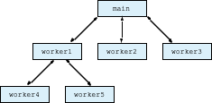
Program Modules in C
Hierarchical boss function/worker function relationship.

Slide 9
Function Definitions
Function definition format
return-value-type function-name( parameter-list ) { declarations and statements }
Function-name: any valid identifier
Return-value-type: data type of the result (default int)
void – indicates that the function returns nothing
Parameter-list: comma separated list, declares parameters
A type must be listed explicitly for each parameter unless, the parameter is of type int

Slide 10
Function Definitions
Function definition format (continued)
return-value-type function-name( parameter-list ) { declarations and statements }
Definitions and statements: function body (block)
Variables can be defined inside blocks (can be nested)
Functions can not be defined inside other functions
Returning control
If nothing returned
return;
or, until reaches right brace at the end of function.
If something returned
return expression;

Slide 11
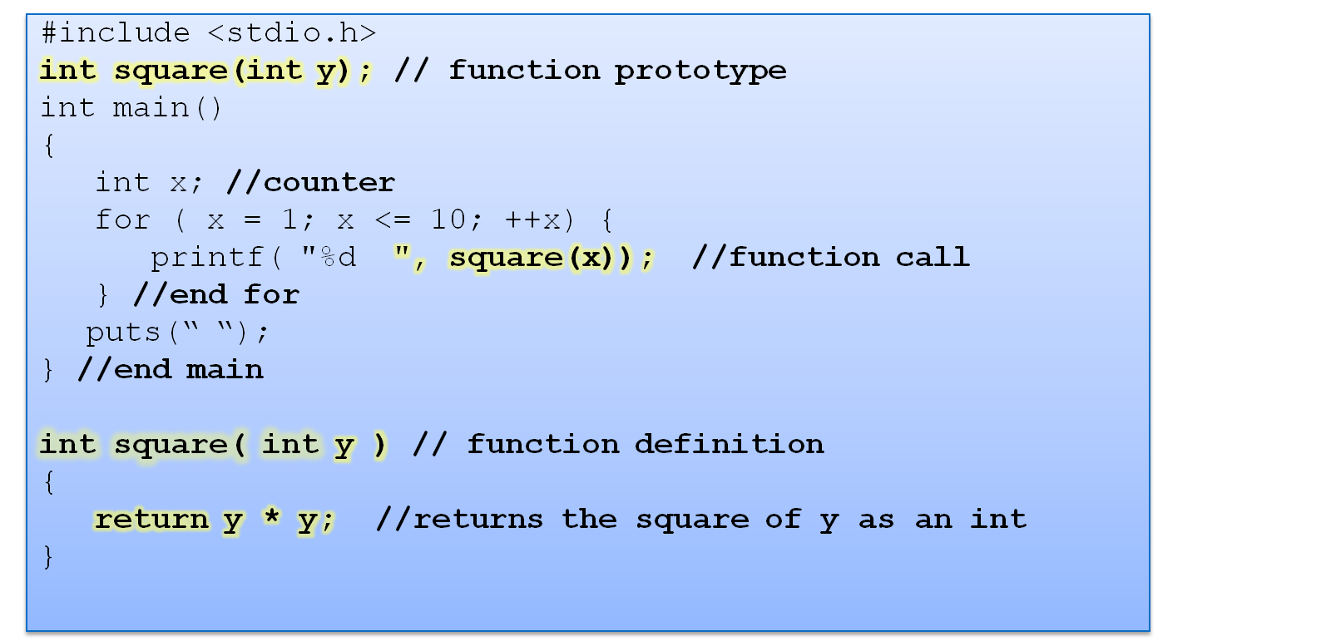
1 4 9 16 25 36 49 64 81 100

Slide 12
Function Prototypes
Function prototype
Function name
Parameters – what the function takes in
Return type – data type function returns (default int)
Used to validate functions
Prototype only needed if function definition comes after use in program
The function with the prototype
int square( int y);
Takes in 1 int data.
Returns an int
Promotion rules and conversions
Converting to lower types can lead to errors

Slide 13
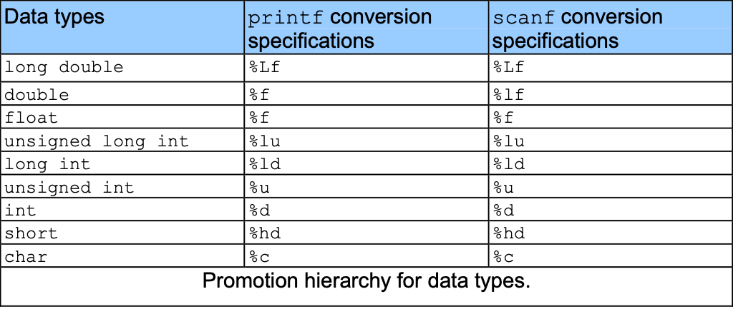
Function Prototypes
The argument values that do not correspond to the parameter types in the function prototype are converted to the proper type before function is called.
This is done according to promotion hierarchy of data types in type conversion.
The types lower in the table is converted to types higher in the table.

Slide 14
Default return type of function is:
void
int
char
float

Slide 15
Output of following code
#include <stdio.h>
int main()
{
int i=7;
printf(“%d%d%d%d",i++,i,++i,i+1);}
8 9 9 8
9 9 9 8
8 9 10 11
7 8 9 10

Slide 16
#include <stdio.h>
int main()
{
void show()
{
printf("hello");
}
show();
}
A. hello
B. No output
C. compiler error

Slide 17
#include <stdio.h>
void show();
int main()
{
show();
printf("hello");
}
void show()
{
printf(" World");
}
1. Hello World
2. World Hello
3. WorldHello
4. HelloWorld

Slide 18
#include <stdio.h>
void show();
int main()
{
show();
printf("hello");
}
void show()
{
printf("World");
main();
}
1. HelloWorld
2. WorldHello
3. World will be printed infinite times
4. Worldhello will be printed infinite time

